Slide 1
Equality as sameness
Anthropological perspectives on the Norwegian society
Thorgeir Kolshus, Department of social anthropology

Slide 2
An anthropological perspective implies:
trying to see phenomena as they appear from the native’s point of view
portraying lifeworlds in a way that makes them probable. «If I were born and bread here, I would share those ideas, ideals and goals»
but also, to assume the outsider’s stance, and actively compare the particular features of the society in question with other sociocultural systems, in order to identify the human commonalities obscured by the particularities

Slide 3
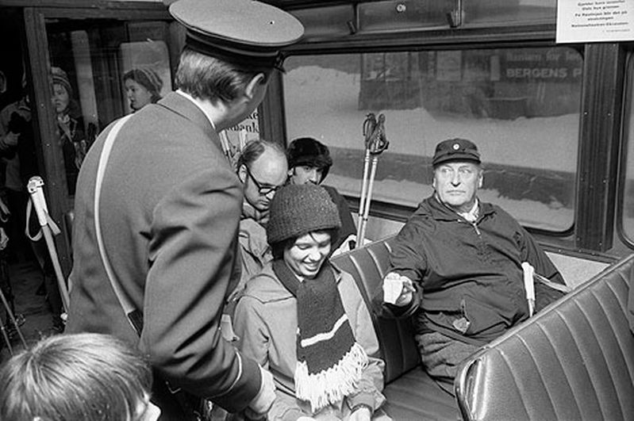
Learning objective:

Slide 4
But first, a native’s view – possibly ironic
http://www.youtube.com/watch?v=ebqdwQzmSHM

Slide 5
Gate-keeping concepts
Key cultural notions or phenomena that cannot be ignored when approaching a culture area/ethnographic region
Examples:
Gift-giving in Melanesia
The caste system in South Asia
For the Nordic countries:

Slide 6
Equality as sameness
This entails:
People who eat, drink, consume and act more or less the same are also believed to share the same values and therefore consider themselves, and are considered by others, as equals in a more fundamental sense
In Norden, there is a passion for equality

Slide 7
The flip side of this coin
1 People who appear/are regarded as different are excluded from certain informal social arenas
2 Hierarchical elements and tendencies remain concealed, as they are willfully subdued and situations in which there could be conflicting values are avoided, which leads to:
3 The key narrative of Norwegian cultural homogeneity is rarely challenged
4 Difference equals inequality: little tolerance of others’ seemingly hierarchical arrangements, regarding gender, financial differences, etc.

Slide 8
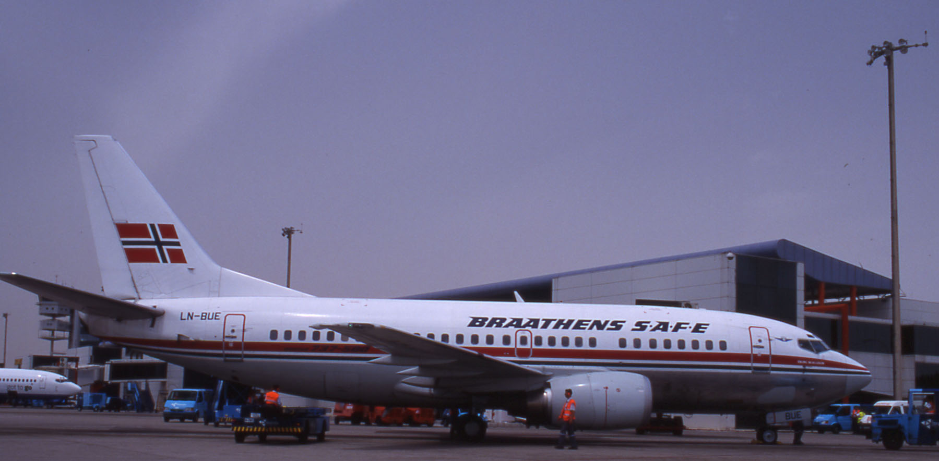
The sad tale of the original Norwegian flag carrier

Slide 9
Aware of Norwegian exceptionality
http://www.youtube.com/watch?v=ZHnfsY7XF30

Slide 10
Competitor SAS
Introduced the concept of Business Class, to replace First Class on European and intercontinental flights
No-class system within the Nordic countries
Still: Braathens had 70% of the lucrative Norwegian market
“Svensk Alt Sammen” vs The Norwegian Flag Carrier
But then …

Slide 11
Recipe for bankruptcy,
Norwegian style
BEST
Reintroduced the curtain
Food, newspapers, coffee adjusted to human tastebuds’ adaption to alteration in cabin pressure
BACK (not ‘bak’, but still)
No frills
Food available for purchase, at a fraction of the extra ticket cost

Slide 12
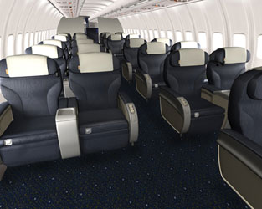
And the consequence …
Three years later, Braathens’ entire assets were acquired by SAS

Slide 13
What made this such a disastrous miscalculation of the market?
Conspicuous consumption is rare: nobody would like to publicly display their lack of economic savvy
But, more critical: BACK equals “standing with your cap in your hand” (å stå med lua i handa)
Norwegians bow to no-one who believes himself entitled to a bow – and by not bowing, we confirm our equality (key Norwegian courtesy code!)
The Norwegian flag carrier lost every legitimacy for ignoring these crucial aspects of Norwegian mentality

Slide 14
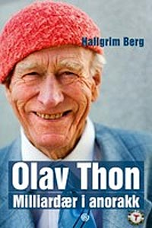
Billionaire in windbreaker
– he’s an Equal.

Slide 15
And what does he have for lunch?

Slide 16
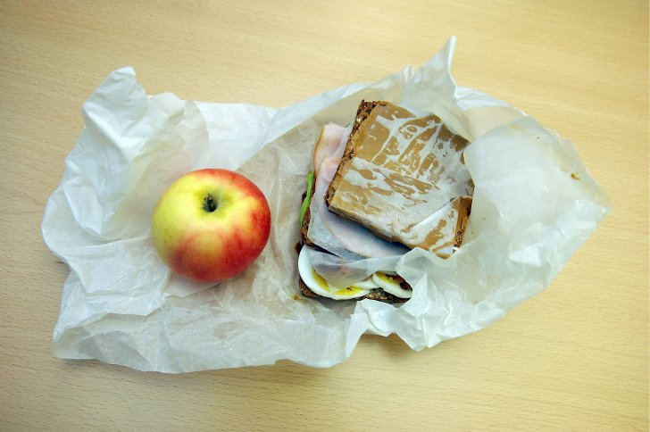
The matpakke
We are what we eat – the same
Pietism and efficiency
Spread in tandem with the Norwegian welfare state
Current dietary conflicts

Slide 17
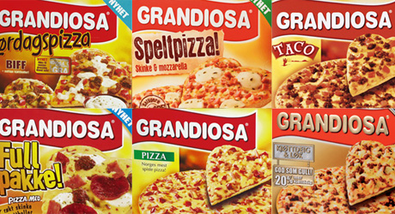
24 million annually …

Slide 18
The changing ethnicity of the Folkepizza
Marianne E. Lien Marketing and Modernity Oxford: Berg 1997
1980: Italian (imagined cuisines: all pizzas are Italian)
Late 80s: American pizza (crust too thick to pass as Italian)
Early 1990s → The Norwegian Pizza
370 million in 30 years

Slide 19
No dissin’ the taste of the Equals
http://www.youtube.com/watch?v=pIb-boiAnRM

Slide 20
And if you do …
The label ‘elitist’ is imminent
Elitists are simply not Equals
Writer Nikolaj Frobenius: “In our minds, the welfare state is all-inclusive to such an extent that the possiblity of falling on the side of society simply does not exist. The position of the outsider is consequently a matter of elitist choice, not of disfranchisment.”

Slide 21
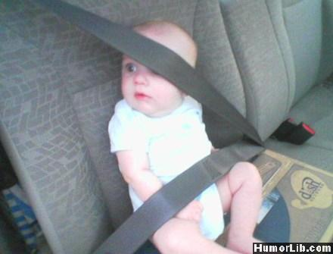

Slide 22
We, the State
State religiosity: The eschatological dimension of government
The state as guarantor for equality, rendering the Norwegian democracy its particular flavor.
Sweden and Norway: Unparalleled trust in the UN and other “faceless” bureaucratic bodies
Long-term experience of a benevolent state, which wishes well and indiscriminately fulfils its purpose to the betterment of society and consequently the individual
This is the paradox of Norwegian collective individualism

Slide 23
Consequences
Tax evasion is no national sport
We have trouble conceiving the reality of self-serving bureaucracies – i.e. an inability to realise that governments also are cultural products
We believe in our own myths – for instance the UN Human Development Index
Complete faith in the state’s ability to deliver the perfectly fair and non-discriminatory society
“… in 2011, in the world’s richest country”
A schizophrenic combination of universalism (our model fits the world) and exceptionalism (We, who have no equal under the sun)

Slide 24
Culture and logical scandals
Cultures are not seamless entities: Contradictions flourish
But, what appears from the outside as inconsistencies and logical scandals, is not necessarily experienced as such

Slide 25
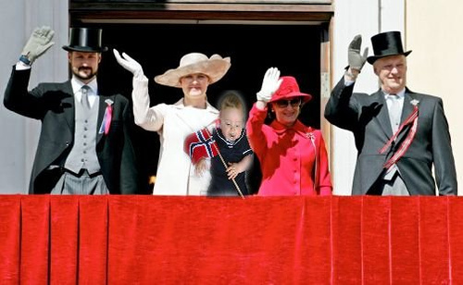
Norwegian monarchy, a logical scandal?
Privelege by birth, in a fiercely egalitarian meritocracy, with little tolerance for hierarchies
Louis Dumont’s theory of encompassment and the hierarchy of values

Slide 26
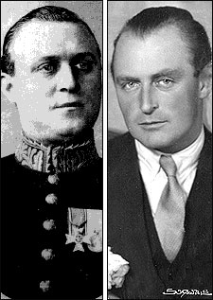
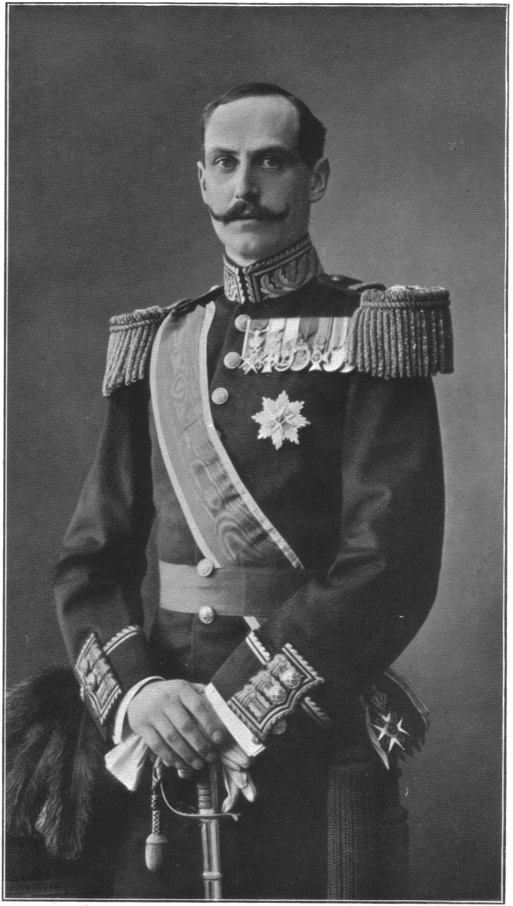
It’s not who you are, but how you are

Slide 27
Equality as overarching value
As long as we and they do, consume and wear the same, we are all equals
The royal family is the symbolic embodiment of this key principle

Slide 28
The greatest scandal of all
Not the horse-whispering angelically-oriented princess (“Everybody has a crazy sister”)
Nor the promiscuous past of the coming queen (“Everybody has a slutty cousin”)
But Johnny from Stovner/Hackney/les banlieues, on the other hand ...

Slide 29
Until …
King Harald’s coup d’etat in 2008
Virtually uncommented in Norwegian media
Was this too culturally challenging?

